Slide 1
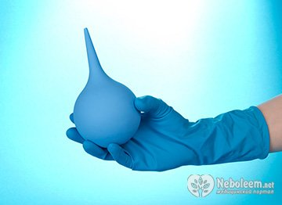
Practical lesson № 17
Theme: «Enemas»

Slide 2
Practical lesson № 14
Theme: «Enemas»
CONTROL QUESTION
Enema, definition.
Classification enemas.
Cleansing enema. Purpose. Mechanism of action. Indication. Type. Used solution.
Methods used in given a large-volume cleansing enema.
Retention enema. Purpose. Mechanism of action. Indication. Type. Used solution.
Carminative enema. Return flow enema. Purpose. Mechanism of action.
The contraindications for cleansing enema.
General instruction for Giving Enema.
PRACTICAL SKILLS
Cleansing enema.
Retention (oil) enema.
Application of colonic tube (flatus tube).

Slide 3
Enema - a medical manipulation, the essence of which is the introduction of the liquid into a direct or colon through the anus.
Enema is a procedure of administration different fluids in lower section of colon for therapeutic and diagnostic purpose.

Slide 4
For therapeutic purposes enemas are used for a very long time. In ancient Indian manuscripts are described prominately enema.
There are records of such treatment and in the Egyptian sources. Hippocrates developed the method of cleansing enemas from harmful juices by gastric lavage, laxatives and cleansing enemas.
Especially the widespread use of enemas in the treatment received in 16 - 18 centuries, when patients put sometimes up to 10 enemas in a row.
Enemas are classified into four groups according to their action:
cleansing,
carminative,
retention,
return-flow enemas.

Slide 5
CLEANSING ENEMAS
A cleansing enema is probably the most common
type of enema.
Purpose. Cleansing enemas are intended to remove feces.
Mechanism of action. This type of enema stimulates peristalsis via irritation of the colon/rectum and by causing intestinal distention with fluid.
They are given chiefly to (indication):
Remove feces in instances of constipation.
Prepare the intestine for certain diagnostic tests such as x-ray or visualization tests (e.g., colonoscopy)
Prepare the patient for surgery (prevent the escape of feces during surgery).

Slide 6
There are two general types of cleansing enemas:
the large-volume enema
the small-volume enema.
A large-volume enema is designed to clean the colon of as much feces as possible. In a large-volume enema between 500 and 1500 ml of fluid is instilled into the rectum/colon and the patient is asked to retain the fluid as long as possible. This allows the fluid to soften and loosen the feces.
The large volume of fluid also distends the bowel, stimulating peristalsis.

Slide 7
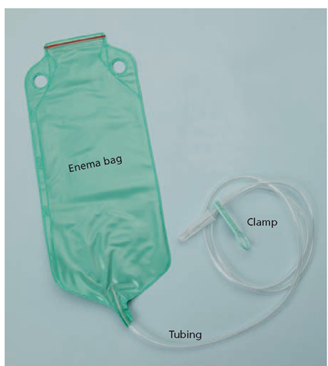
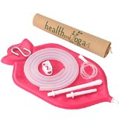
Methods used in given a large-volume cleansing enema:
enema set (the rectal tip, enema bag, tubing)
enema bag

Slide 8
Skill 1. CLEANSING ENEMA
Purpose: Emptying of the lower part of the colon from feces and gases.
Indications:
Remove feces in instances of constipation.
Prepare the intestine for certain diagnostic tests such as x-ray or visualization tests (e.g., colonoscopy)
Prepare the patient for surgery (prevent the escape of feces during surgery).
Counter-indications:
GI bleeding
Acute inflammatory and ulcerous processes in a colon or anus
Anal fissure
Rectal cancer
Bleeding hemorrhoids
The first days after operation on organs of the digestive system
Equipment. Sterile: enema bag, tubing, rectal tube (or enema set), gauze napkins, spatula, Vaseline, tray.
Unsterile: stand, oilcloth and diaper (or absorbent pad), container with water (volume 1 liters), basin (or bedpan), screen, oilcloth apron, disposable latex gloves, container for waste of A and B class.
Algorithm of action:
Explain to the patient the purpose and procedure course. Obtain patient’s consent.
Conduct hygienic washing hand and processing hand. Put the gloves on.
Prepare the equipment.
Isolate the patient with a screen.
Place the absorbent pad (oilcloth and diaper) on bed under patient. Place the patient in left lateral position with flexed legs.
Wear an apron on itself.
Prepare the enema set: Attach a rectal tube to the tubing. Hang the enema bag with the solution on the stand. Close the clamp of enema bag. Prepare the solution at the required temperature. Enemas administered to adults are usually given at 16°C-38°C. The solution should be 30–45 cm above the rectum for an adult. Fill the enema bag with a solution. Loosen the clamp and let a small amount of fluid to run into the basin (to release the air). Close the clamp.
Take the lubricant (Vaseline) with spatula. Lubricate rectal tube with Vaseline.
Spread patient buttocks with thumb and forefinger of the left hand.
Insert the rectal tube 7 to 10 cm slowly into the rectum, directing it toward the umbilicus.
Open the clamp of enema bag.
Slowly enter the about 500 to 1000 ml of fluid in the rectum.
Control for patients condition. Ask the patient to breath by abdomen.
Clamp the tubing.
Gently remove the rectal tube by pulling it through 3 to 4 layers of rag pieces.
Offer to the patient to take the water in the intestine during 10-15 minutes.
Empty the intestine in bedpan or toilet pan.
Conduct disinfection used material. Take the gloves off and put them in the container for waste of B class.
Wash hands.
Record the type of enema. Record result.

Slide 9
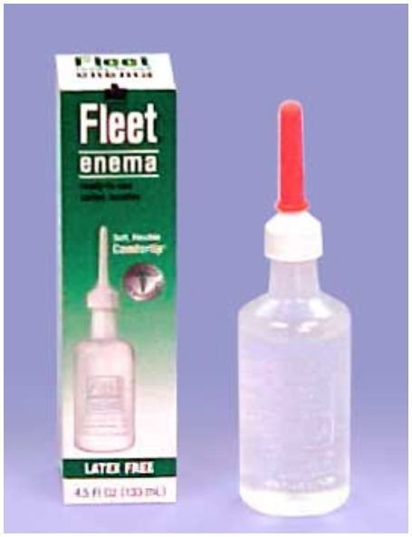
Small-volume enemas are designed to clear the rectum and the sigmoid colon of fecal matter. Small volume enemas can be delivered with the traditional enema kit using 50 to 200 ml of solution.
But most frequently small-volume enemas are administered using a prepackaged disposable enema. Prepackaged enemas (Fleet enema) are easily administered and available over the counter in most drug stores.

Slide 10
Cleansing enemas. Solution used:
large-volume enema:
Hypotonic (Tap water)
Isotonic solution (Norman saline)
Soapsuds (3-5 ml soap and 1500 ml water)
Small-volume enemas:
Hypertonic solution
The water temperature for cleaning enema:
atonic constipation – 16°C - 20°C (60,8- 68° F)
spastic constipation – 37°C - 38°C (98,6-100,4° F)
in other cases – 23°C - 25°C (73,4-77° F)

Slide 11
The contraindications for cleansing enema
Gastric and intestinal bleeding
Acute inflammatory and ulcerous processes in a colon or anus
Rectal cancer
Cracks in the anus or rectal prolapse
The first days after operation on organs of the digestive system
Bleeding hemorrhoids

Slide 12
Retention enema.
Retention enema introduces oil or medication into the rectum and sigmoid colon. The liquid is retained for a relatively long period of time, usually 1 to 3 hours. It acts to soften the feces and to lubricate the rectum and anal canal, thus facilitating the passage of feces.
The effect in 3-6 hours.
Solution used: oil (olive, cottonseed, castor, mineral), medication. Temperature of the solution – 37,7°C.

Slide 13
Skill 2. RETENTION (OIL) ENEMA
Purpose: soft emptying of lower section of colon from fecal matter and gases (these are given to soften faecal matter)
Indications:
1. inefficiency the cleansing enema
2. the first days after operation on organs of abdominal cavity
3. after childbirth
Counter-indications:
Bleeding of intestine
Ulcerous processes in a colon or anus
Rectal prolapse
Rectal cancer
Equipment. Sterile: colonic tube, Janet's syringe with oil solution in a volume of 50–200 milliliters, oil (medication), gauze napkins, tray. Unsterile: gloves, oilcloth and diaper (or absorbent pad), apron, screen, container for waste of A and B class.
Algorithm of action:
Explain to the patient the purpose and procedure course. Obtain patient’s consent.
Conduct hygienic washing hand and processing hand. Put the gloves on.
Prepare the equipment.
Isolate the patient with a screen.
Place the absorbent pad (oilcloth and diaper) on bed under patient. Place the patient in left lateral position with flexed legs.
Wear an apron.
Moisten the end of the colonic tube on the distance of 20-30 cm by lubricant (Vaseline).
The rounded end colonic tube to take as a pen.
Spread patient buttocks with thumb and forefinger of the left hand.
Insert the colonic tube 20 to 30 cm slowly into the rectum, directing it toward the umbilicus.
Attach the Janet's syringe to colonic tube and enter the oil solution.
Disconnect the Janet's syringe from the tube.
Gently remove the colonic tube by pulling it through 3 to 4 layers of rag pieces.
Wipe the anus with napkin.
Remove the diaper and oilcloth. Take off an apron, gloves and put into container for waste of B class.
Help patient to take a comfortable position. Give him recommendation - to lie during 6- 10 hours. Therefore this procedure should be done for the night.
Wash hands.
Record the type of enema. The result.

Slide 14
Medications can be administered by enema as well. A small-volume enema can deliver a medicated solution directly to the rectal mucosa. This method of medication administration is useful when the rectum is the area to be medicated if the client is unable to take oral medications or if rapid absorption of the medication is required.

Slide 15
Carminative enema
Carminative enema. This is given primarily to expel flatus. The solution instilled into the rectum releases gas, which in turn distends the rectum and the colon, thus causing peristalsis. 60-180 ml of fluid is introduced.
An alternative method for flatulence - application of colonic tube (flatus tube).

Slide 16
APPLICATION OF COLONIC TUBE (flatus tube)
Purpouse: evacuation gases of intestine
Indications:
1. Meteorism (bloat) - accumulation of gases in intestine.
2. Using for staging of medicinal and oil enemas
Counter-indications:
Gastric and intestinal bleeding
Acute inflammatory and ulcerous processes in a colon or anus
Anal fissure
Rectal cancer
Bleeding hemorrhoids
Equipment. Sterile: colonic tube, vaseline, tray, gauze napkins.
Unsterile: gloves, screen, oilcloth, diaper, apron, bedpan with water, container for waste of A and B class.
Algorithm of action:
Explain to the patient the purpose and procedure course. Obtain patient’s consent.
Conduct hygienic washing hand and processing hand. Wear gloves.
Prepare the equipment.
Isolate the patient with a screen.
Place the absorbent pad (oilcloth and diaper ) on bed under patient. Place the patient in left lateral position with flexed legs.
Wear an apron.
lubricate the end of the colonic tube on the distance of 20-30 cm by Vaseline.
The rounded end colonic tube to take as a pen.
Spread patient buttocks with thumb and forefinger of the left hand.
With a gentle rotatory movement, Insert the colonic tube 20 to 30 cm slowly into the rectum, directing it toward the umbilicus.
The free end of the tube being kept into the water in the kidney tray (or bedpan).
Leave the colonic tube on 20 minutes.
Wear gloves. Remove the colonic tube from the rectum using a napkin.
Put the colonic tube in container with disinfectant solution. Wipe the anus with napkin. Remove the bedpan, the diaper and the oilcloth. Take off an apron, gloves and put into container with disinfectant solution.
Wash hands.
Record the type of enema. The result.
NOTE: The tube can be re-inserted every 3 to 4 hour, if necessary.

Slide 17
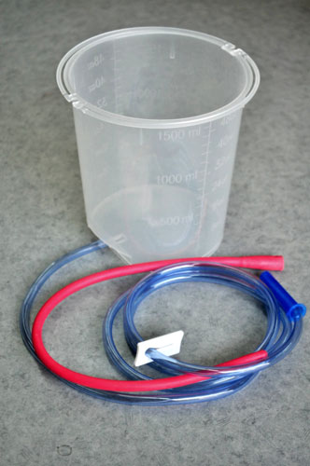
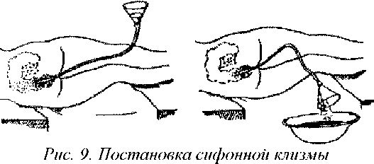
Return flow enema. Return flow enema is used Referred also as colonic irrigation, this is used to expel flatus. This involves the alternating flow of fluid into and out of the large intestine to stimulate peristalsis and the expulsion of feces.

Slide 18
General instruction for Giving Enema
1. Use the appropriate size catheter or rectal tube.
2. The rectal tube needs to be atraumatic.
3. Use lubricant.
4. Follow the temperature of solution.
5. Follow the amount of the solution.
6. Keep the correct patient position.
7. Keep the height of the enema bag.
8. Follow the depth introduction of rectal tube.
9. Follow the time of retention of solution in intestines.
10. Good condition equipment.
11. Follow the flow speed of fluid.
12. Prevent air from entering into the rectum .
13. Observe the patient's condition during the procedure.

